Slide 1

Analysis of Algorithms
CS 477/677
Binary Search Trees
Instructor: George Bebis
(Appendix B5.2, Chapter 12)

Slide 2
Binary Search Trees
Tree representation:
  A linked data structure in which each node is an object
Node representation:
  Key field
  Satellite data
  Left: pointer to left child
  Right: pointer to right child
  p: pointer to parent (p [root [T]] = NIL)
Satisfies the binary-search-tree property !!
parent
L
R
key
data
Left child
Right child

Slide 3
Binary Search Tree Property
Binary search tree property:
  If y is in left subtree of x,
    then key [y] ≤ key [x]
  If y is in right subtree of x,
    then key [y] ≥ key [x]
5
3
7
2
5
9

Slide 4
Binary Search Trees
Support many dynamic set operations
  SEARCH, MINIMUM, MAXIMUM, PREDECESSOR, SUCCESSOR, INSERT, DELETE
Running time of basic operations on binary search trees
  On average: Θ(lgn)
    The expected height of the tree is lgn
  In the worst case: Θ(n)
    The tree is a linear chain of n nodes

Slide 5
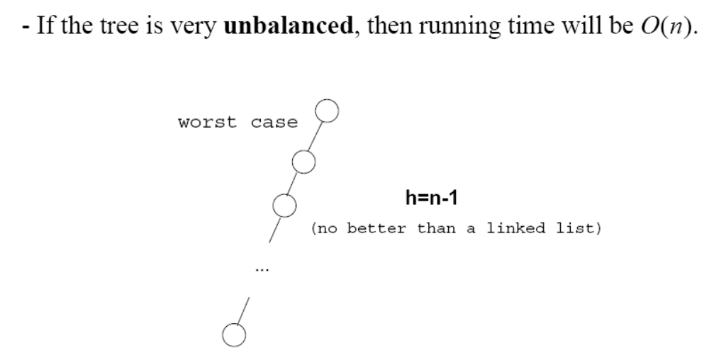
Worst Case
Θ(n)

Slide 6
Traversing a Binary Search Tree
Inorder tree walk:
  Root is printed between the values of its left and right subtrees: left, root, right
  Keys are printed in sorted order
Preorder tree walk:
  root printed first: root, left, right
Postorder tree walk:
  root printed last: left, right, root
Inorder: 2 3 5 5 7 9
5
Preorder: 5 3 2 5 7 9
3
7
Postorder: 2 5 3 9 7 5
2
5
9

Slide 7
Traversing a Binary Search Tree
Alg: INORDER-TREE-WALK(x)
if x ≠ NIL
then INORDER-TREE-WALK ( left [x] )
print key [x]
INORDER-TREE-WALK ( right [x] )
E.g.:
Running time:
  Θ(n), where n is the size of the tree rooted at x
5
Output: 2 3 5 5 7 9
3
7
2
5
9

Slide 8
Searching for a Key
Given a pointer to the root of a tree and a key k:
  Return a pointer to a node with key k
  if one exists
  Otherwise return NIL
Idea
  Starting at the root: trace down a path by comparing k with the key of the current node:
    If the keys are equal: we have found the key
    If k < key[x] search in the left subtree of x
    If k > key[x] search in the right subtree of x
5
3
7
2
4
9

Slide 9
Example: TREE-SEARCH
15
Search for key 13:
  15 → 6 → 7 → 13
6
18
3
7
17
20
2
4
13
9

Slide 10
Searching for a Key
Alg: TREE-SEARCH(x, k)
if x = NIL or k = key [x]
then return x
if k < key [x]
then return TREE-SEARCH(left [x], k )
else return TREE-SEARCH(right [x], k )
5
3
7
2
4
9
Running Time: O (h),
h – the height of the tree

Slide 11
Finding the Minimum in a Binary Search Tree
Goal: find the minimum value in a BST
  Following left child pointers from the root, until a NIL is encountered
Alg: TREE-MINIMUM(x)
while left [x] ≠ NIL
do x ← left [x]
return x
Running time: O(h), h – height of tree
15
6
18
3
7
17
20
2
4
13
9
Minimum = 2

Slide 12
Finding the Maximum in a Binary Search Tree
Goal: find the maximum value in a BST
  Following right child pointers from the root, until a NIL is encountered
Alg: TREE-MAXIMUM(x)
while right [x] ≠ NIL
do x ← right [x]
return x
Running time: O(h), h – height of tree
15
6
18
3
7
17
20
2
4
13
9
Maximum = 20

Slide 13
Successor
Def: successor (x ) = y, such that key [y] is the smallest key > key [x]
E.g.: successor (15) =
successor (13) =
successor (9) =
Case 1: right (x) is non empty
  successor (x ) = the minimum in right (x)
Case 2: right (x) is empty
  go up the tree until the current node is a left child: successor (x ) is the parent of the current node
  if you cannot go further (and you reached the root): x is the largest element
17
15
15
6
18
13
3
7
17
y
20
x
2
4
13
9

Slide 14
Finding the Successor
Alg: TREE-SUCCESSOR(x)
if right [x] ≠ NIL
then return TREE-MINIMUM(right [x])
y ← p[x]
while y ≠ NIL and x = right [y]
do x ← y
y ← p[y]
return y
Running time: O (h), h – height of the tree
15
y
6
18
3
7
17
20
x
2
4
13
9

Slide 15
Predecessor
Def: predecessor (x ) = y, such that key [y] is the biggest key < key [x]
E.g.: predecessor (15) =
predecessor (9) =
predecessor (7) =
Case 1: left (x) is non empty
  predecessor (x ) = the maximum in left (x)
Case 2: left (x) is empty
  go up the tree until the current node is a right child: predecessor (x ) is the parent of the current node
  if you cannot go further (and you reached the root): x is the smallest element
13
15
y
7
6
x
18
6
3
7
17
20
2
4
13
9

Slide 16
Insertion
Goal:
  Insert value v into a binary search tree
Idea:
  If key [x] < v move to the right child of x,
  else move to the left child of x
  When x is NIL, we found the correct position
  If v < key [y] insert the new node as y’s left child
else insert it as y’s right child
  Begining at the root, go down the tree and maintain:
    Pointer x : traces the downward path (current node)
    Pointer y : parent of x (“trailing pointer” )
Insert value 13
12
5
18
2
9
15
19
1
3
13
17

Slide 17
Example: TREE-INSERT
Insert 13:
x=root[T], y=NIL
y
12
12
x
5
18
5
18
2
9
15
19
2
9
15
19
1
3
17
1
3
17
12
12
x
y
5
18
5
18
2
9
15
19
2
9
15
19
1
3
17
1
3
13
17
x = NIL
y = 15

Slide 18
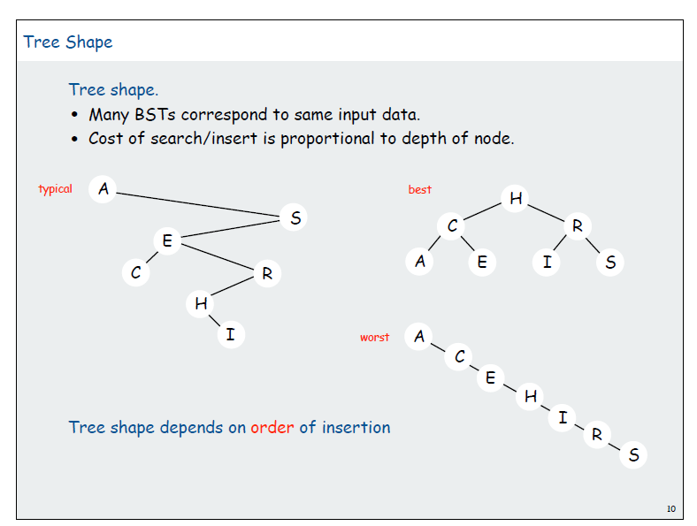
Alg: TREE-INSERT(T, z)
y ← NIL
x ← root [T]
while x ≠ NIL
do y ← x
if key [z] < key [x]
then x ← left [x]
else x ← right [x]
p[z] ← y
if y = NIL
then root [T] ← z Tree T was empty
else if key [z] < key [y]
then left [y] ← z
else right [y] ← z
12
5
18
2
9
15
19
1
3
13
17
Running time: O(h)

Slide 19
Deletion
Goal:
  Delete a given node z from a binary search tree
Idea:
  Case 1: z has no children
    Delete z by making the parent of z point to NIL
15
15
5
16
5
16
3
12
20
3
12
20
z
10
13
18
23
10
18
23
6
delete
6
7
7

Slide 20
Deletion
Case 2: z has one child
  Delete z by making the parent of z point to z’s child, instead of to z
15
delete
15
z
5
16
5
20
3
12
20
3
12
18
23
10
13
18
23
10
6
6
7
7

Slide 21
Deletion
Case 3: z has two children
  z’s successor (y) is the minimum node in z’s right subtree
  y has either no children or one right child (but no left child)
  Delete y from the tree (via Case 1 or 2)
  Replace z’s key and satellite data with y’s.
6
15
15
delete
z
5
16
6
16
3
12
20
3
12
20
10
13
18
23
10
13
18
23
y
6
7
7

Slide 22
TREE-DELETE(T, z)
if left[z] = NIL or right[z] = NIL
then y ← z
else y ← TREE-SUCCESSOR(z)
if left[y] ≠ NIL
then x ← left[y]
else x ← right[y]
if x ≠ NIL
then p[x] ← p[y]
z has one child
z has 2 children
15
y
5
16
x
3
12
20
10
13
18
23
6
7

Slide 23
TREE-DELETE(T, z) – cont.
if p[y] = NIL
then root[T] ← x
else if y = left[p[y]]
then left[p[y]] ← x
else right[p[y]] ← x
if y ≠ z
then key[z] ← key[y]
copy y’s satellite data into z
return y
y
15
5
16
x
3
12
20
10
13
18
23
6
7
Running time: O(h)

Slide 24
Lazy Deletion Trick
One trick to do, is to have an extra flag per node
Each time you need to delete a node, just mark it as deleted
Do batch processing
That is after N deletion, rebuild the tree from start
This is not so efficient, but a nice trick if you need to delete and worry of coding mistakes

Slide 25
Binary Search Trees - Summary
Operations on binary search trees:
  SEARCH O(h)
  PREDECESSOR O(h)
  SUCCESOR O(h)
  MINIMUM O(h)
  MAXIMUM O(h)
  INSERT O(h)
  DELETE O(h)
These operations are fast if the height of the tree is small – otherwise their performance is similar to that of a linked list

